Slide 1

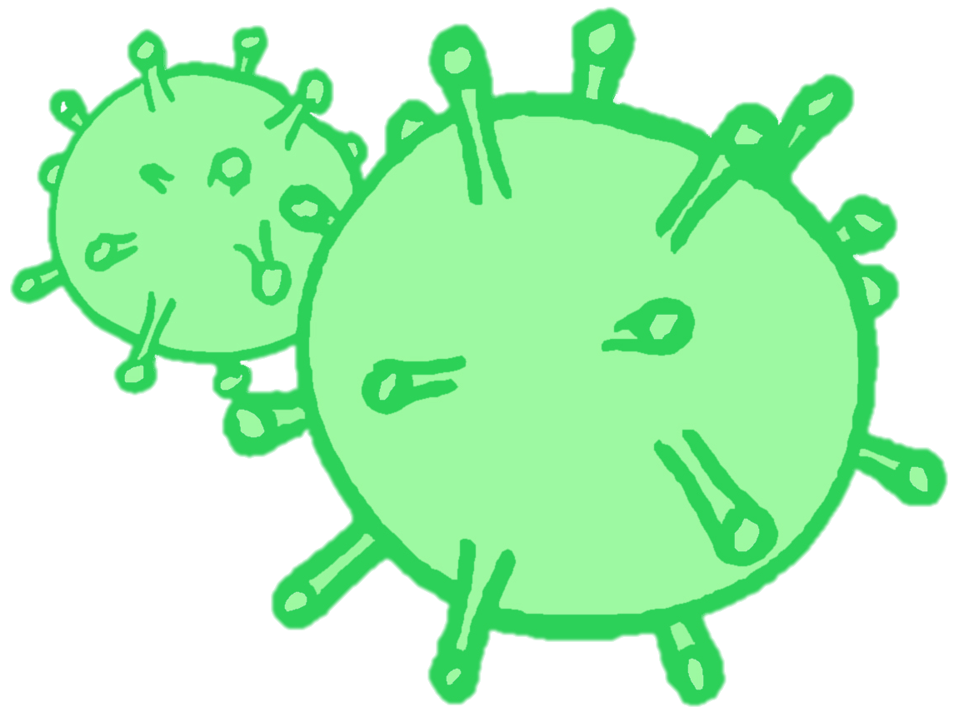
CONTRACEPTION & STI’s
Year 10 Health Lesson 5 Term 2, 2024

Slide 2
Term Timeline:
Week 5 STI’s.
Week 6 = STI’s + Task 3: STI Oral Presentations.
Week 7 = Work on assignment.
Week 8 = EXAM BREAK.
Week 9 – 11 = Assignment Presentations.
- ALL assignments are due in week 9 and names will be drawn at random.
Notes:
Year 10 Social Event on Thursday week 11 (27th June)

Slide 3

Today’s Focus
Define STI and the different types.
Practice STI prevention.

Slide 4

OPTIONAL:
https://create.kahoot.it/share/duplicate-of-sti-s/c27f6ea9-2b50-418b-812a-25b134679b46
Notes:
OPTIONAL ACTIVITY
https://create.kahoot.it/share/duplicate-of-sti-s/c27f6ea9-2b50-418b-812a-25b134679b46

Slide 5

Activity 1: Handshake Activity
Notes:
RESOURCES – print O + X’s worksheet (available on shared drive/connect). Make sure there are enough, so each student gets one shape (either O or X).
Everyone in the class receives a piece of paper with either a O or a X on it (can give these out as students walk through the door).
**Give the X to students who won’t mind being told they spread an STI or will go around and be lively in shaking hands.**
All students need a pen.
Students need to walk around and shake hands with each other.
If you have an O, you write an O on the other person's paper when you shake hands.
If you have an X, you write an X on the other person’s paper when you shake hands.
If you are an O and shake hands with an X, and now have an X on your paper, you are now an X and will continue to write X on other people’s paper when you shake hands.
Allow 1-2 minutes to walk around and shake hands.
Debrief:
Stand up the people who have the X shape on their paper. Stay standing.
Stand up if you shook hands with one of these people. Stay standing.
Now stand up if you shook hands with one of these people.
Everyone with an X on their paper now has an STI.
This activity is used to demonstrate that STI’s can be invisible and can be easily transmitted through skin-to-skin contact.

Slide 6

Notes:
OPTIONAL
STI House – 2:26mins

Slide 7

SPIT FIRE: Types of STI’s
Notes:
After watching the video, ask students to recall the STI’s that were mentioned.

Slide 8

GLOSSARY: (pg. 7)
Sexually Transmitted Infection:
An infection most commonly spread through unprotected sexual contact.
At the front of your books is your glossary.
Turn to your glossary and add the following words and their definitions:

Slide 9
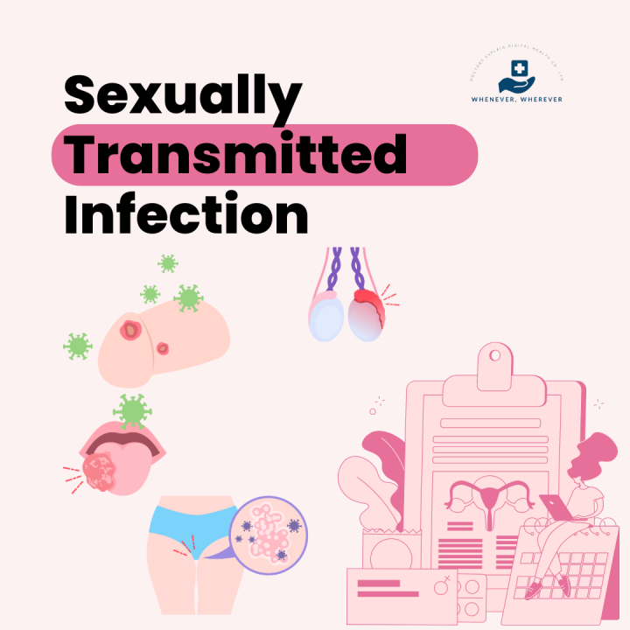
What are sexually transmitted infections? (pg. 18)
STI’s are bacterial or viral infections that are most commonly passed through unprotected sexual contact with an infected partner:
Oral sex
Vaginal sex
Anal sex
Skin-to-skin contact
For transmission to occur, it is necessary to have
A body fluid with the germ in it
A way of spreading the germ from one person to the other
STI’s can also be transmitted during pregnancy, childbirth and breastfeeding and through infected blook or blood products.
Notes:
Inform students that STI’s and STD’s mean the same thing (Infections vs. Diseases) but that STI’s is the language more commonly used now.
The concepts of disease suggests a clear medical problem, usually some obvious signs/symptoms. But commonly, many sexually transmitted diseases do not have obvious signs/symptoms or have mild signs that can be easily overlooked. So, the term ‘infection’ is more commonly used now, though may or may not result in a ‘disease’.

Slide 10


Body fluids – which one’s are considered infectious?
Semen
Vaginal Fluid
Blood
Fluid in blisters or sores
Saliva
Urine
Sweat
Ear wax
Tears

Slide 11
METHODS OF TRANSMISSION: Low Risk or No Risk
Abstaining
Hugging
Kissing
Holding hands
Dancing
Sitting on toilets
Sharing lip balm
Mutual monogamy
Massage
Sharing forks, knives, etc.
STI’s need a host body, and without that they cannot survive.
**Kissing can spread an STI, such as Herpes (cold sores), if there is a sore is present at the time.

Slide 12
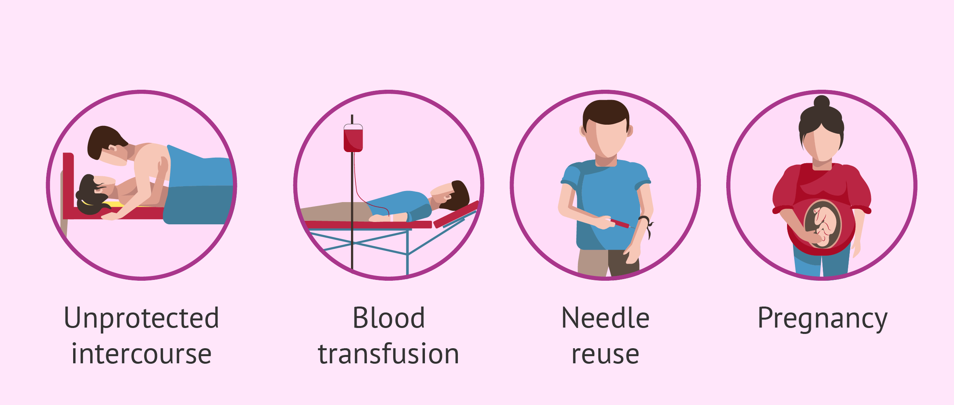
METHODS OF TRANSMISSION: High-Risk (pg. 18)
Sexual Intercourse
vaginal
anal
oral
Blood-to-blood contact or blood infusion
Sharing needles or other drug-use equipment
Tattoo or body piercing
Infected mother to her baby

Slide 13
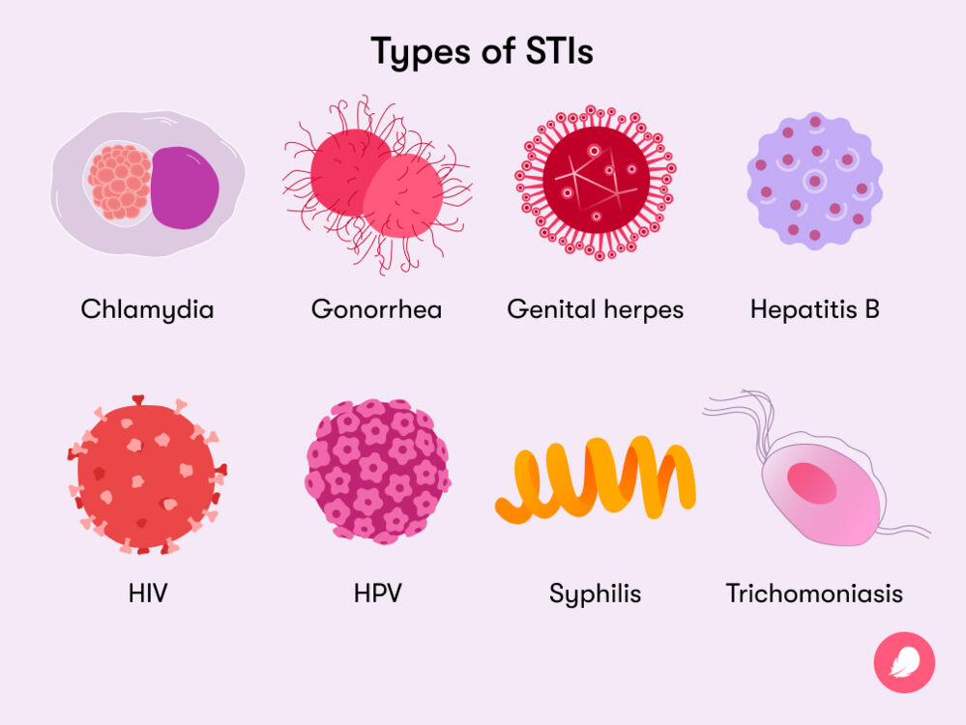
TYPES of STI’s: (pg. 19)
BACTERIAL – an infection caused by a bacteria.
Treatable and curable with antibiotics.
If untreated can cause long term side-effects.
Chlamydia (most common), Gonorrhoea (‘the clap’), Syphilis, Trichomoniasis.
VIRAL – an infection caused by a virus.
Cannot be cured.
Medication to treat symptoms only.
Can pass onto others for the rest of your life.
Human Papilomavirus (HPV), HIV/AIDS, Herpes Simplex Virus (HSV), Hepatitis B.
3. PARASITIC – an infection caused by a parasite.
Can be cured/treated
Public lice (crabs), Trichomoniasis, Scabies

Slide 14

WARNING: GRAPHIC CONTENT
Over the next collection of slides we will be going over the different types of STI’s – what they are, signs and symptoms, treatment etc.
Some slides will contain graphic images.
Use the information to write your own notes onto pg.20 in your books.
This information can be used later to assist you with your assignment.
Notes:
Over the next collection of slides a variety of STI’s will be shown. While following along, students can write their own notes into the space provided on pg.20 of their workbooks. The main purpose is to introduce them to the different STI’s and generate discussion. When students are presenting their assignments, the audience will need to complete a table about each different STI that is presented. By the end of the presentations, students will have collated more information on all the different STI’s into their workbooks.

Slide 15
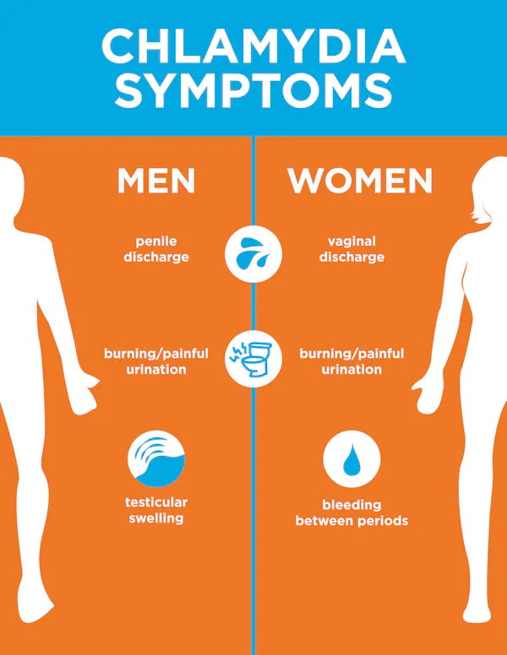
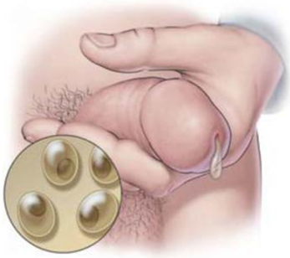
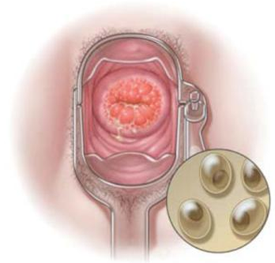
Chlamydia
Among the most common bacterial STIs in the world. In WA, most common in people <25 years.
Passed by having unprotected oral, anal or vaginal sex.
Condoms can help prevent the spread of chlamydia.
Most people have no symptoms.
The infection can be cured with a single dose of antibiotics.
If untreated it can affect the cervix, urethra, uterus, fallopian tubes, rectum, throat, eye, and can cause ectopic pregnancy or infertility.
Remember Chlamydia is
CURABLE!

Slide 16
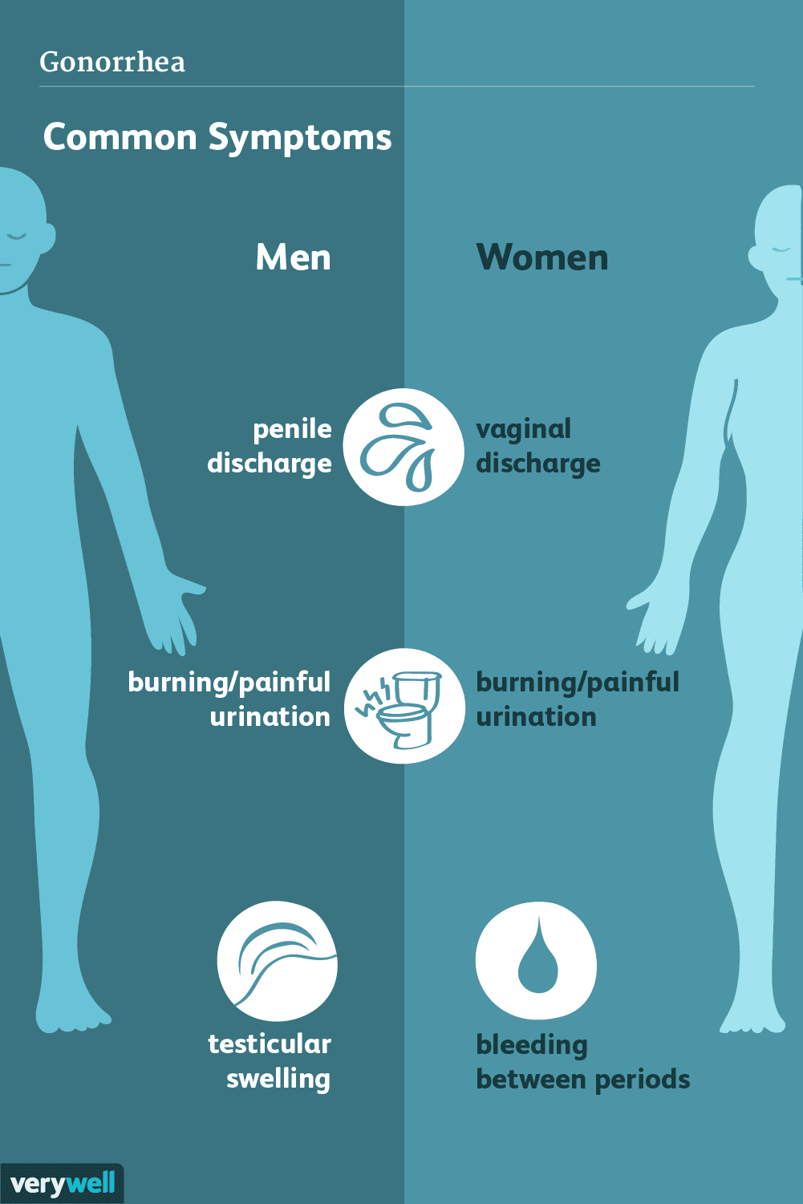
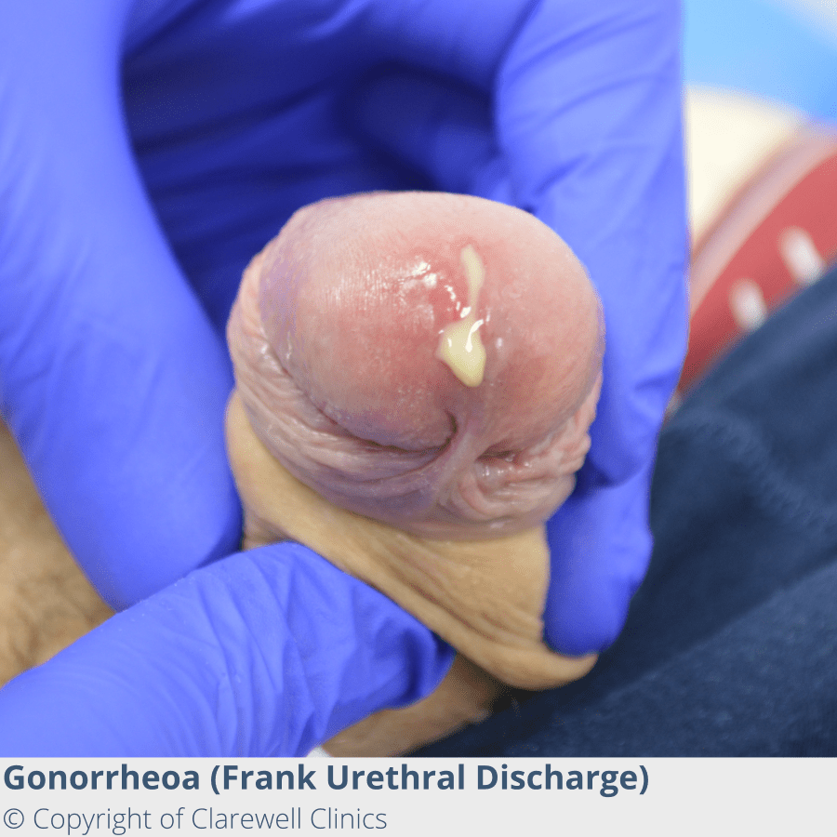
Gonorrhea
Second most common bacterial infection and is most common in 15-29 year-olds.
Passed along by having unprotected oral, anal or vaginal sex.
Condoms can help prevent the spread of gonorrhea.
Most people have no symptoms, especially in females.
The infection can be cured with antibiotics.
Female:
Vaginal discharge
Painful urination
Bleeding after sex
Bleeding between periods
Pain during sex
Lower abdominal pain
Male:
Thick, yellowish-green discharge from penis
Painful urination
Testicular pain or swelling
Rectal pain, discharge or itching.
Remember Gonorrhea is CURABLE!

Slide 17
Syphilis
Bacterial infection.
Can cause serious damage to the body if not cured.
Passed along by having unprotected oral, anal or vaginal sex.
Condoms can help prevent the spread of syphilis.
The infection can be cured with antibiotics.
There are 4 stages of syphilis infection: primary, secondary, latent and tertiary.
Symptoms vary depending on the stage.
Some people have no symptoms.
Stage 1 = Primary
Small, painless sores
Stage 2 = Secondary
Rash, hair loss, feeling sick, weight loss, muscle aches
Stage 3 = Latent
Lesions or rashes can recur but there may also be no visible signs or symptoms
Stage 4 = Tertiary
Can affect heart, blood vessels, brain, nervous system
Would occur 10-30 years after initial infection
Can result in death
Remember Syphilis is CURABLE!
Notes:
Syphillis Can spread from an infected mother to her unborn child

Slide 18
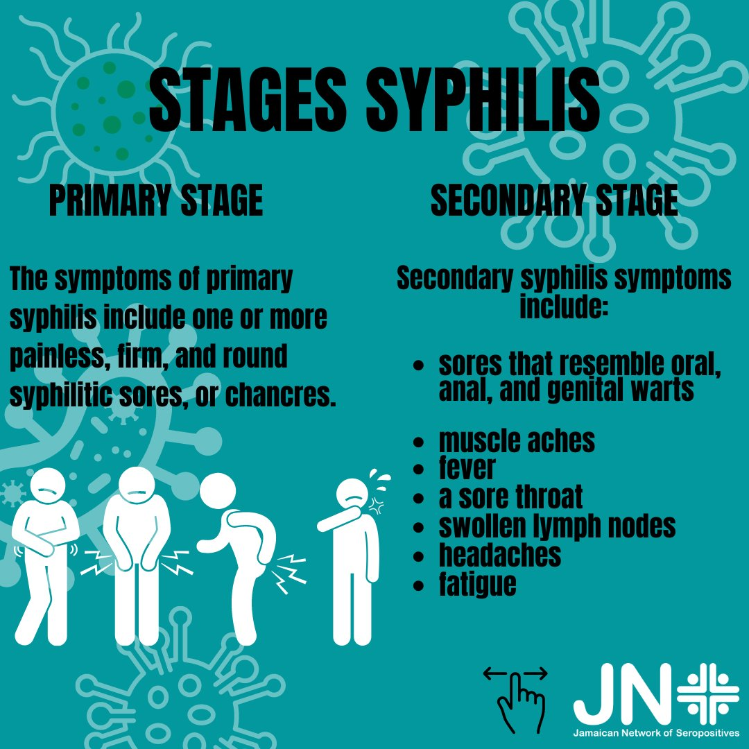
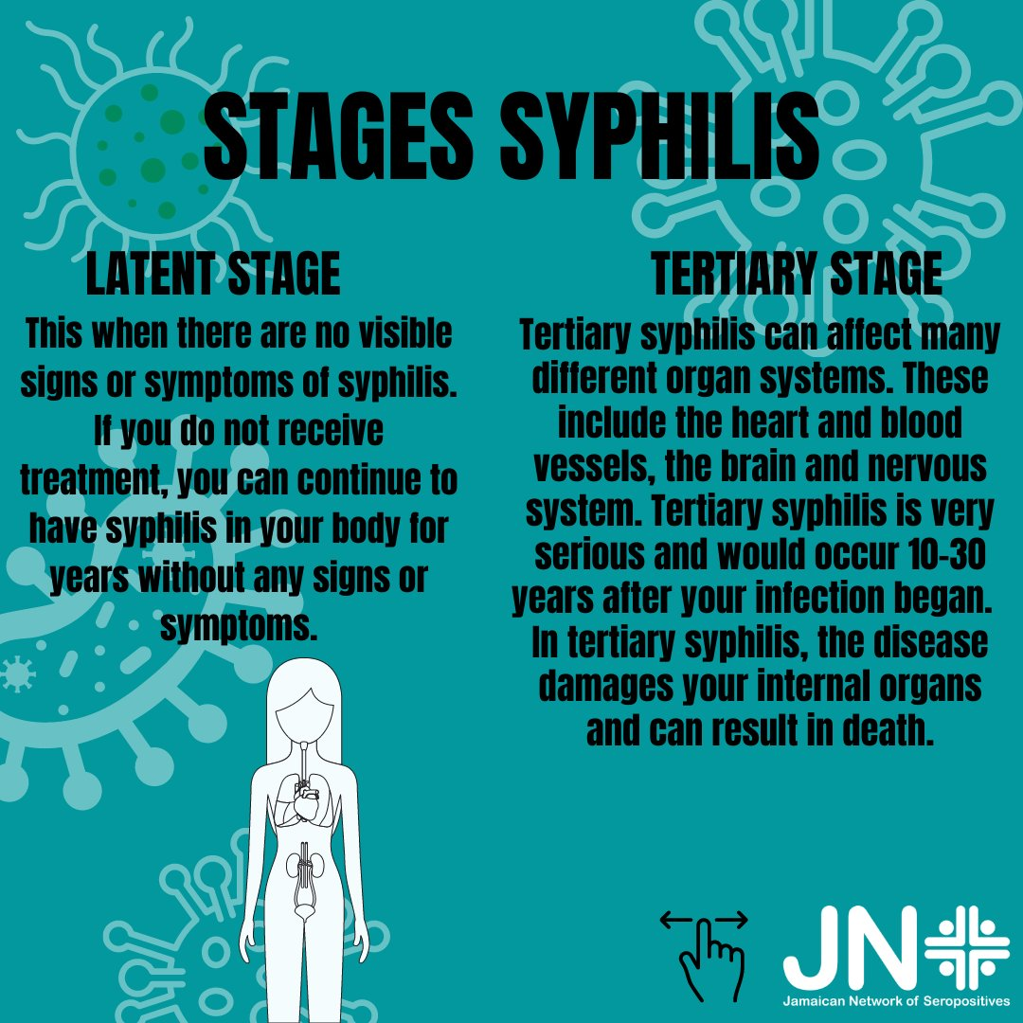
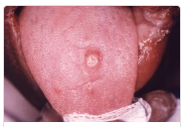
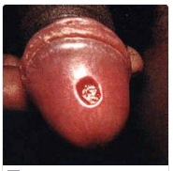
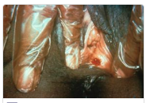
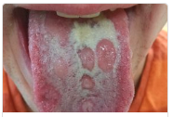
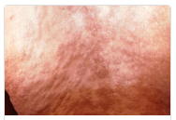
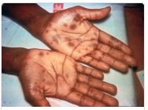
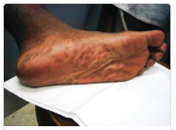
Primary Stage:
Secondary Stage:
Notes:
Primary Syphilis: a painless open sore which heals on it’s own, but the infection remains

Slide 19
Herpes Simplex Virus (HSV 1 + 2)
Two types of Herpes Simplex Virus (HSV).
HSV 1 = causing cold sores
HSV 2 = causes genital herpes
Viral infection causing outbreaks of painful sores and blisters.
Passed along by having unprotected oral, anal or vaginal sex with an infected partner, or kissing.
There is NO cure.
Symptoms can be managed with medication.
Virus can lay dormant in your body and recur at different times.
Signs & Symptoms:
Prior to an outbreak, the person may feel a tingling or burning sensation where the virus first entered the skin
Painful sores (external or internal)
Inflammation and redness
Fever
Muscular pain
Tender lymph nodes

Slide 20
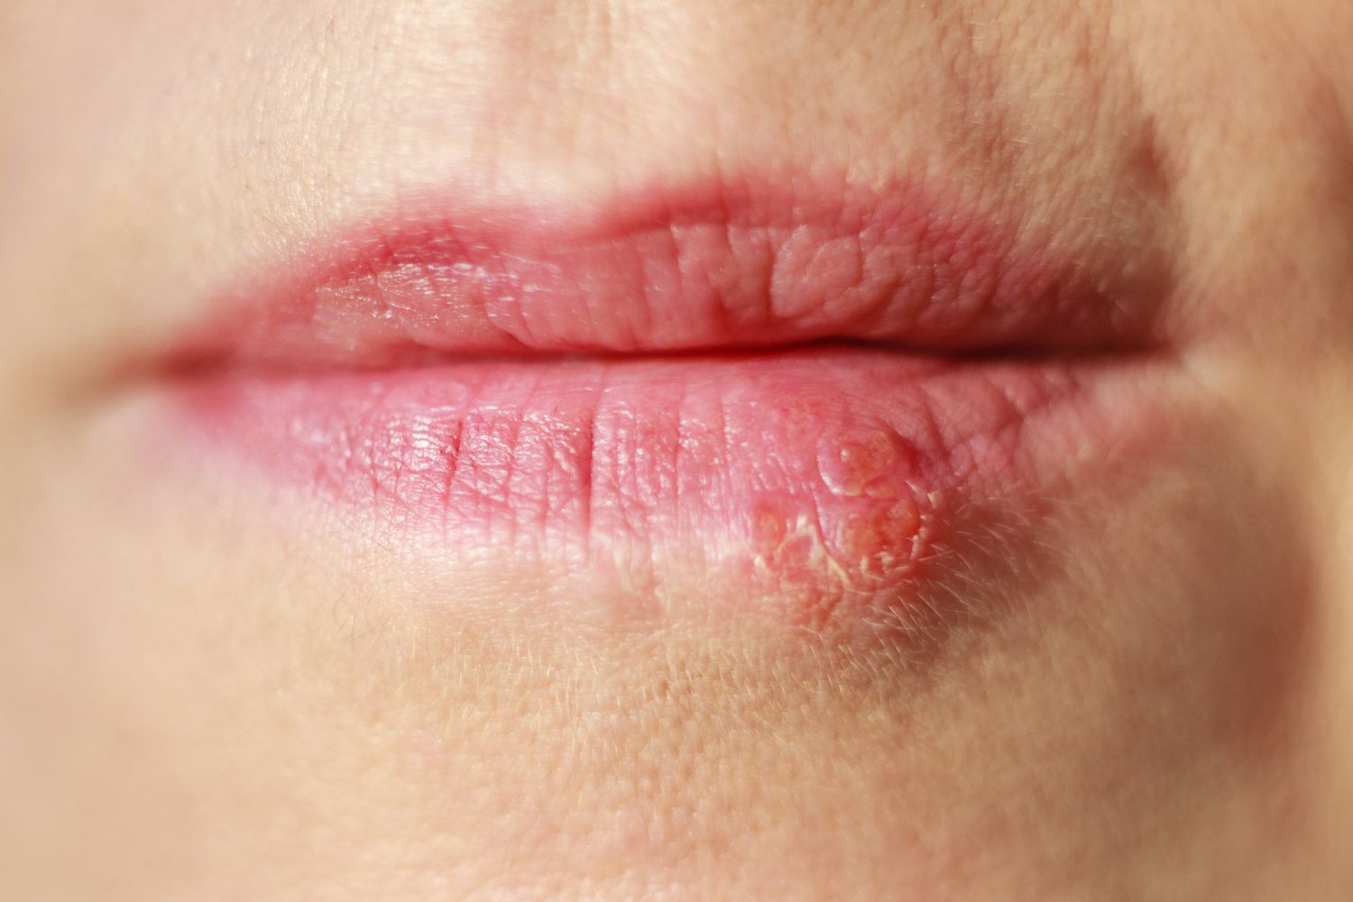
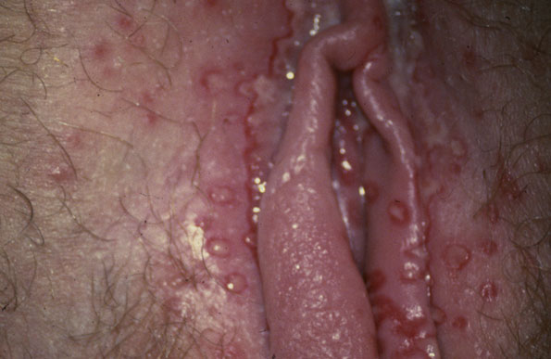
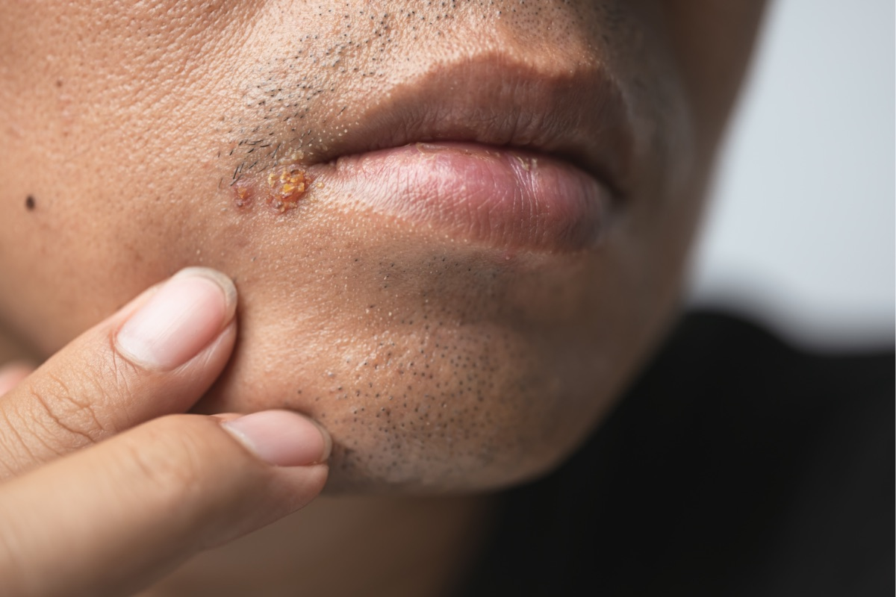
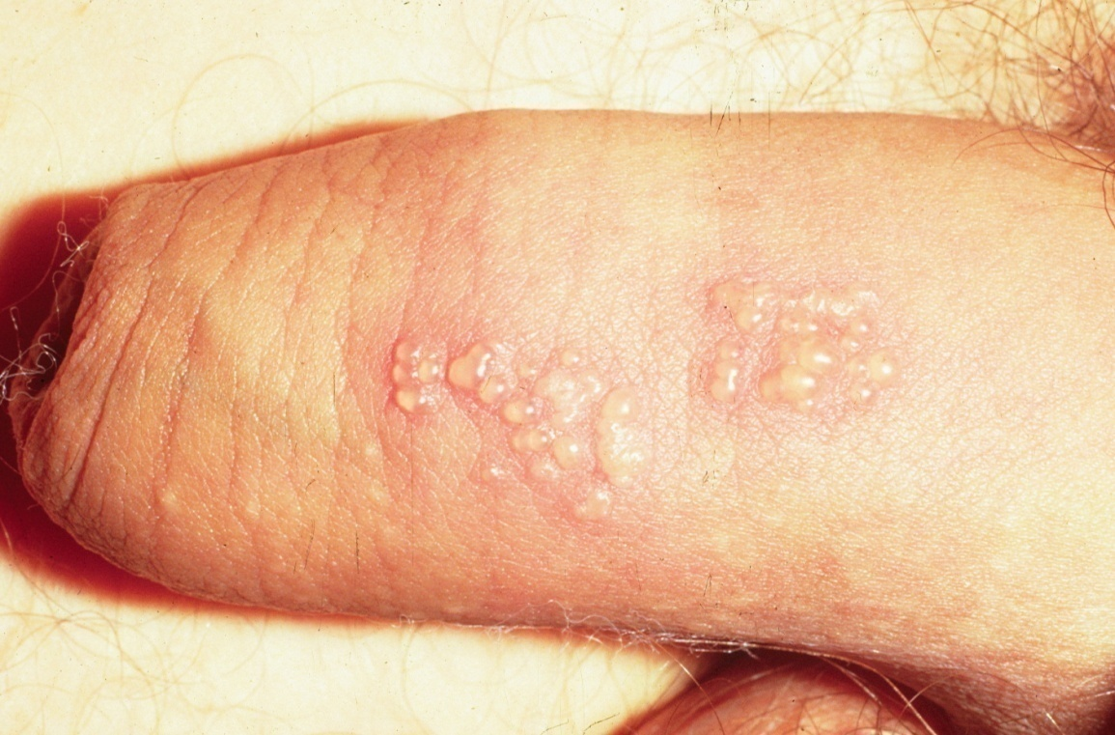
HSV 1
HSV 2 (genital)

Slide 21
Human Papilomavirus (HPV) / Genital Warts
Viral infection.
Spread through skin-to–skin contact, even if there are no symptoms, or through unprotected vaginal, anal or oral sex.
Can also be passed from mother to baby during childbirth.
Many different types – some can cause warts (non-cancerous), and some can cause cancers.
Sometimes there are no symptoms, other times it causes genital warts, pain during sex, itchiness or painless warts.
Vaccine available.
Warts treatment can include freezing, cutting, burning or zapping.
Notes:
HPV can cause cervical cancer, anal cancer, vaginal cancer, throat cancer, vulva cancer, penile cancer.
Vaccine available for the type that causes most genital warts, 90% of cervical cancers and 95% of other HPV related cancers.

Slide 22
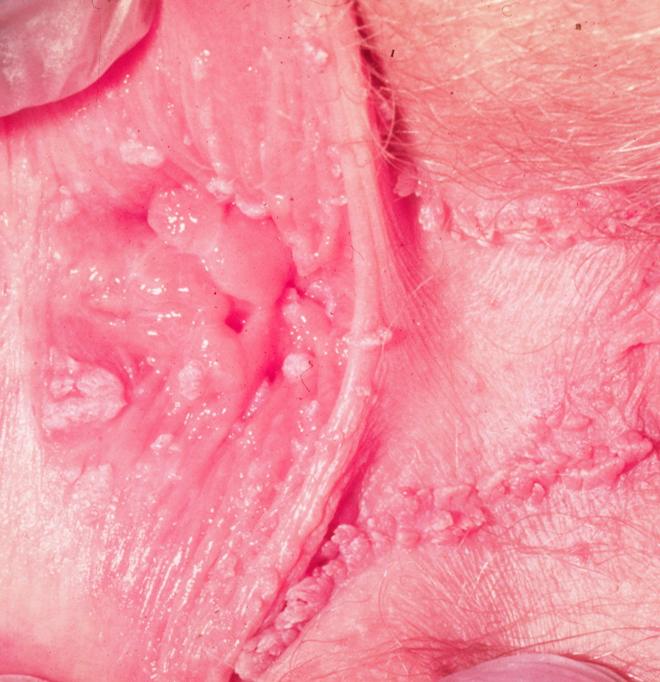
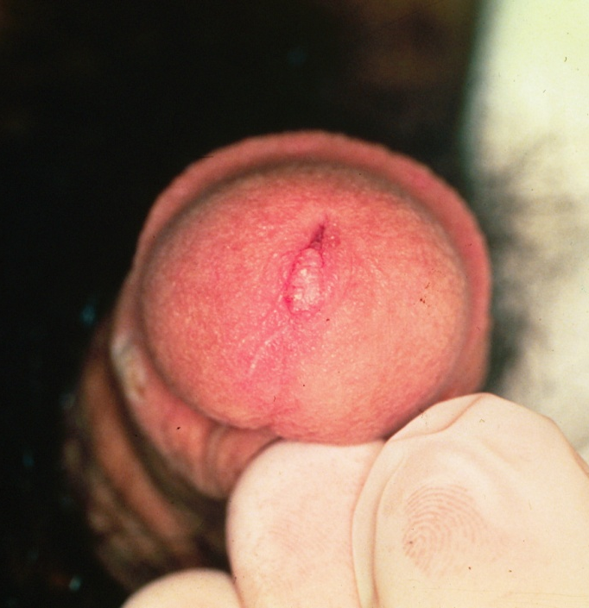
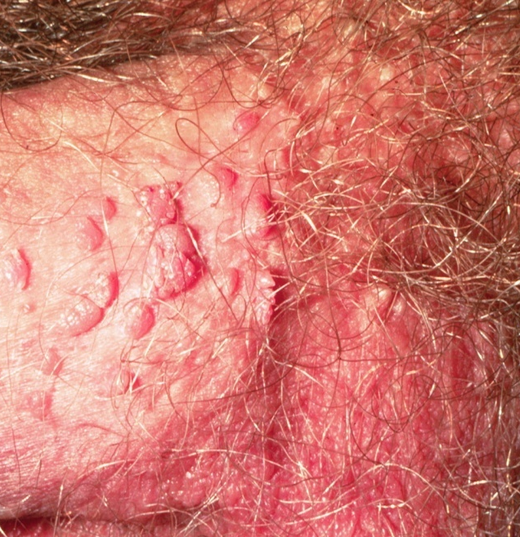
Human Papilomavirus (HPV) / Genital Warts
Notes:
HPV can cause cervical cancer, anal cancer, vaginal cancer, throat cancer, vulva cancer, penile cancer.
Vaccine available for the type that causes most genital warts, 90% of cervical cancers and 95% of other HPV related cancers.

Slide 23
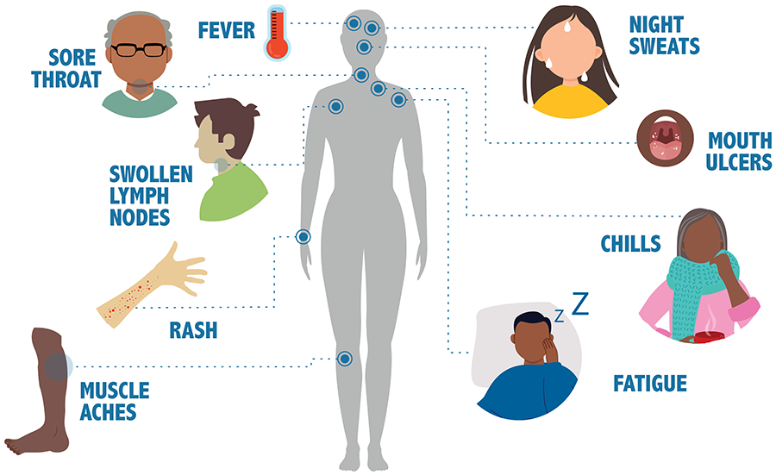
HIV / AIDS
HIV is a viral infection that, over time, leads to the development of AIDS.
HIV = Human Immunodeficiency Virus
AIDS = Acquired Immunodeficiency Syndrome
It attacks the immune system.
No cure – once acquired, the person has it for life. With proper care, HIV can be controlled.
Some people have no symptoms at all, but symptoms can include flu-like symptoms.
The only way to know is to get tested.
HIV is contained in the blood, semen, vaginal fluid and breast milk of an infected person.
Can be spread via unprotected vaginal or anal sex, sharing drug equipment, sharing needles (i.e., tattoos and piercing), transmission from mother to baby, accidental sharps (needle) injuries.
Notes:
Spread initially from chimpanzees when Africans used to hunt them and would come into contact with their infected blood.

Slide 24
Hepatitis B
Hepatitis B is an STI and blood-borne virus (BBV)
Can be passed on through unprotected sexual contact or by blood-to-blood contact (i.e., sharing drug use equipment and needles) or from pregnant mother to baby.
Virus that attacks the liver.
Symptoms include: fever, fatigue, muscle aches, swollen glands, abdominal pains, jaundice, nausea/vomiting, dark yellow urine, pale or grey poo.
Most infected people (90%) naturally produce antibodies to fight the disease, but some develop chronic HBV and will carry the virus for the rest of their life.
Chronic infection can lead to liver damage, cirrhosis, and cancer and has no cure.
Antiviral treatment.
Vaccination available.

Slide 25
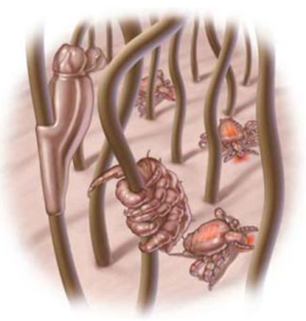
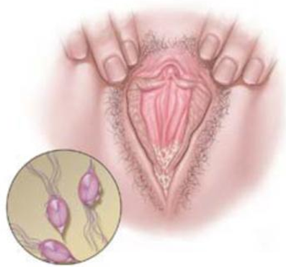
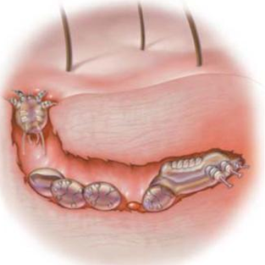
Parasitic STI’s
Pubic Lice
Trichomoniasis
Scabies
The lice attach their eggs to the pubic hair and feed on human blood
Caused by a parasite that is usually sexually transmitted, but it can survive 24 hours on wet towels and bathing suits
Caused by the itch mite. It burrows just under the skin and lays eggs. Can live for 2-4 days away from the human body; it can be transmitted without sexual contact.
Notes:
Spread by sexual contact. Not the same as head lice. Pubic lice do not live on the head and head lice do not live in the pubic area.

Slide 26
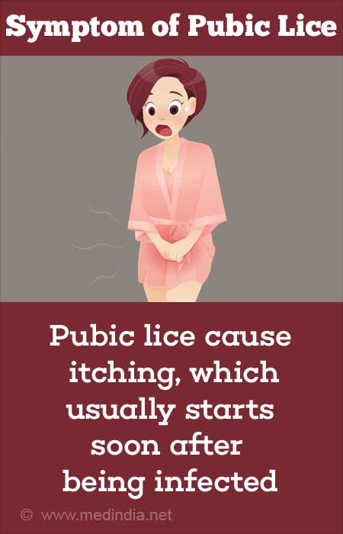
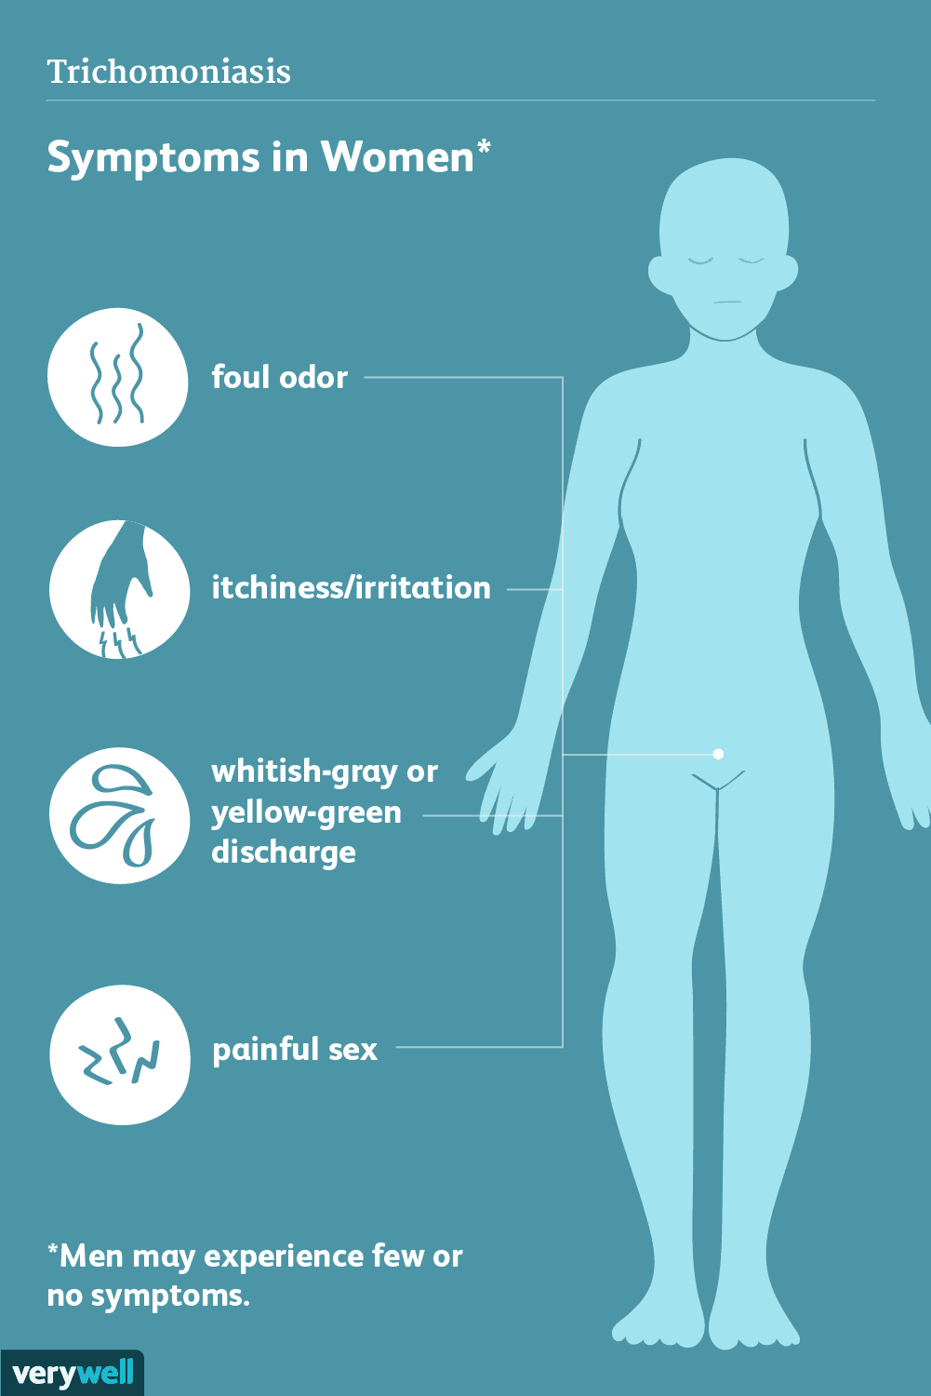
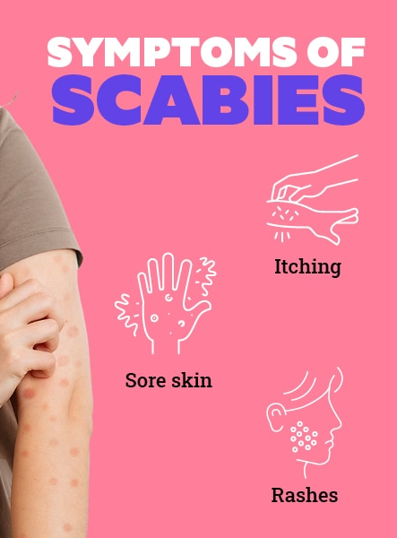
Parasitic STI Symptoms

Slide 27
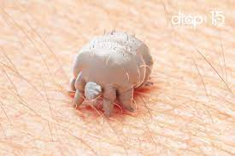
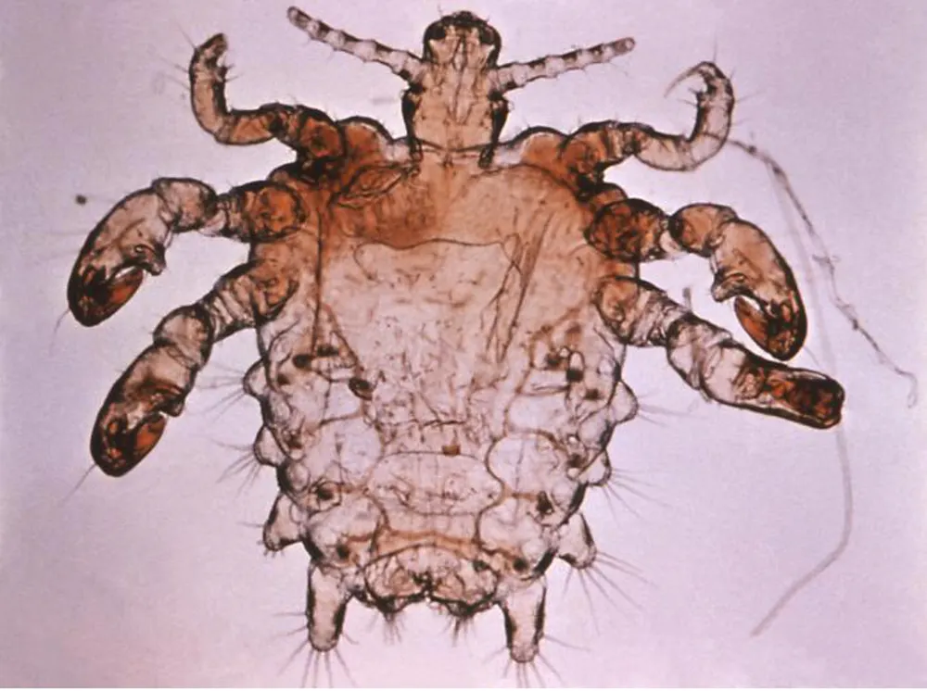
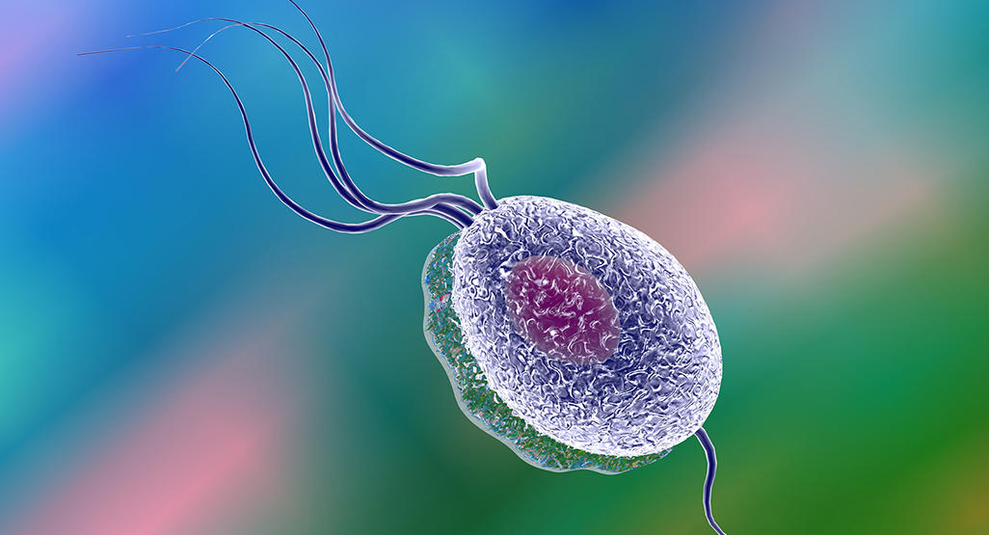
PARASITIC STI Prevention & Treatment
Trichomoniasis
Condoms will help prevent the spread.
Treated with antibiotics.
Pubic lice and Scabies
Avoid sharing towels and clothing that have not been washed.
When trying on bathing suits or underwear in the store always wear something underneath.
Treated with shampoo, lotion or ointment.
Notes:
Trichomoniasis ( trich-o-mo-ni-a-sis) or Trich

Slide 28

Viral STI’s
Herpes
HPV
HIV
Notes:
OPTIONAL ACTIVITY
7:09mins
https://www.youtube.com/watch?v=e6MNzZn4W0w

Slide 29

STI’s are dangerous because…
Common
Can be serious, particularly if left untreated (discomfort, disease, infertility, death)
Not many preventative vaccines (only 2)
Some are incurable
Many have no signs/symptoms
Most spread silently
Notes:
Included in their books (pg.18)

Slide 30
Optional Activity: Condom Activity
Using the condom resources, allow students time to practice how to use condoms.

